Slide 1
Software Engineering and Product-line architectures: problem domain
Roberto Silveira Silva Filho
Department of Informatics
School of Information and Computer Sciences
University of California, Irvine
rsilvafi@ics.uci.edu
First Edition: March 2nd, revision April 27th 2006

Slide 2
Outline
Traditional Software Engineering
Software Engineering for Product Lines (SPL)
SPL Main issues
  Feature Interaction and dependencies
  Bounding
  Variability realization techniques
Pub/sub infrastructures product lines
  Main issues
    Variability dimensions (bounding)
    Feature dependencies

Slide 3
Single-System Software Engineering
Goal: converting High-level specifications into low-level code (machine executable)
  Usually produces one-of a kind software, to solve a specific problem.
  Traditional software process:
    Analysis
    Design
    Implementation
    Testing
    Deployment
    Maintenance

Slide 4
Single-System Software Engineering: General problem
Validated/verified high-level problem description
End user concerns and requirements
Technology concerns
General problem: Map this high-level problem description into computer-understandable code
  Can we divide the problem into sub-problems?
  Does the program complies with the original specification?
Low-level program
0100010010 00010010 110001010 11100101 00101010

Slide 5
Software Product Lines (SPL)
Addresses deficiencies from single-system software engineering

Slide 6
Software reuse motivation
From a software reuse perspective…
Different software systems are usually developed within the same problem domain
  Each time a program is developed, solutions are reinvented or at least re-implemented
In a software domain, usually a product family, systems have large commonality and little variability
  For example: software for cell phones and digital cameras, middleware, etc.
  Variability is defined in terms of hardware and software features
Motivation: how to leverage this commonality in order to reduce software development costs?

Slide 7
Software evolution and maintenance motivation
From a software evolution and maintenance perspective…
Software maintenance is the costly phase in software development
Software needs to change due to:
  Hardware changes
  Input/output data, changes in functionality set, scale requirements [Parnas78]
Motivation: how to make software easier to change and evolve?

Slide 8
Software product line goal
“to capitalize on commonality and manage variation in order to reduce the time, effort, cost and complexity of creating and maintaining a product line of similar software systems”^{(*)}.
The main focus is on:
  Predictive (versus opportunistic) software reuse.
  Mass customization (versus mass production of a single product)
  And NOT extensibility or evolution.
    Even though, one of my goals is both of them.
(*) www.softwareproductlines.com/introduction/concepts.html

Slide 9
Software Product Lines consequences
Consequences
  Short term increase of production costs
  Followed by long term reduction of development costs of new products
  Resulting in a change in the way developers think about software production [Coplein et al 98]
  Flexibility: Software product lines can better accommodate unforeseeable changes
    This is not the primary goal as software product lines but we want to study this point

Slide 10
When to design a product line?
Cost model [Brooks87] [Coplein et al 98]
C0 = cost to develop from
scratch
C1 = cost when using existing
commonalities
A = initial product line
development cost
N = number of members
With product line analysis
Cost = A+N*C1
4*C0
A
3*C0
Cumulative cost
Without product line analysis
Cost = N*C0
2*C0
C0
1
2
3
4
Number of family members

Slide 11
Engineering of Software Product Lines -
General Problem
High-level (similar) problem descriptions
End user concerns and requirements
Base system (incomplete program)
Technology concerns
General problem: Map high-level problem description into a family of computer-understandable code:
  Not only a single program, but a family of similar programs
  Identify commonality
  Manage variability
  Choose appropriate variability realization techniques
commonality
Variability
Program variants – based on different product decisions
0100010010 00010010 110001010 11100101 00101010

Slide 12
Software product line (or domain engineering) process
Apply SVC (Scope Variability Commonality Analysis)
  Select commonalities
  Select variability points
  parameterize
Perform feature dependency and interference analysis
Bound variability with respect to
  Range (variability parameter options)
  Variability Realization Time (runtime, design time, build time)
  The goal is to maximize commonality and manage the variability.
Select appropriate variability realization strategies/techniques
Open questions
  How to test it?
  How much variability to define?
  How dependencies impact bounding and variability realization choices?

Slide 13
General software product line process (a.k.a. domain engineering)
Requirement Analysis
  Application domain analysis
  Identify commonalities and variability
Variability bounding
  Restrict variables
  Decide binding time
    Runtime, build time, design time


●
❍
Feature Analysis
  Optional
  Mandatory
  Exclusive
Feature incompatibilities
Feature dependencies
Feature interferences
Implementation
  Components
  Frameworks
  Aspects
  others
Manage dependencies and interferences

Slide 14
Result of domain engineering (design)
Feature diagrams describing core, optional and exclusive features
Commonalities and variability: decision model
Feature dependency and interference diagrams
Documents that map features to components
  Kernel components (mandatory)
  Optional components (optional or exclusive)
  Selected variability realization techniques

Slide 15
Main Research Challenges in SPL

Slide 16
Main research challenges
Identifying commonalities and variability:
  SVC analysis
  Essential analysis
  Adaptive OO programming
Harnessing Feature interdependencies
  Runtime and usage dependencies between features themselves.
Variability Bounding Time
  Deciding how much variability is needed – the more variability, the harder to develop the infrastructure becomes
Choosing the appropriate Variability realization techniques
Generative Programming: Automation of the SPL process
  The goal is to go from high-level models to application-specific code

Slide 17
Main research challenges (cont.)
Feature modularization
  Features are hard to modularize (separation of concerns)
  N-to-m mapping between features and their implementation (software entities)
  Modules interdependencies or coupling
Feature interaction resolution
  Different features may have components in common
  Feature interference: Features may interfere with one another in unpredictable ways [Cameron, Velthuijsen 93]
  Crosscutting features: a feature implementation is spread through many code fragments throughout different components

Slide 18
Feature dependencies or coupling
[Lee and Kang’04]
Features depended on one another in different ways.

Slide 19
Main sub product of a feature-oriented analysis
Set of features
  Optional
  Mandatory
  Exclusive
Features relationships
  Feature diagram (aggregation, specialization)
Feature dependencies
  Dependencies diagram

Slide 20
Main Types of Feature Dependencies [Lee and Kang’04]
Usage dependency: features depend on sub-features for its implementation
Modification dependency: the behavior of a feature is modified by the presence of another feature.
Activation dependency
  Exclusive activation: features cannot be active at the same time
  Subordinate activation: one feature depends on a sub-feature
    Concurrent: subordinate features must be active at the same time
    Sequential: features must be activated in a proper order.

Slide 21
Dependencies Issues
Those dependencies tend to be hard-coded in the components
  Hindering the evolution and variability of the system
  Resulting in entangled code
  Coupling between features
Solution [Lee and Kang’04]
  Identify the inter-dependencies in the design phase
  Separate the activation dependencies from the components applying:
    Proxy
    Activation Manager
    Factories
  Those solutions above do not address all the fundamental dependencies but mainly address activation dependencies
  They introduce extra overhead, and require variation points to be identified earlier in the design

Slide 22
Feature-specific versus fundamental dependencies
Feature-specific dependencies are those that appear as a consequence of the system design and the extra features supported.
  They can be addressed by some of the techniques proposed by [Lee and Kang’04]
Fundamental dependencies are a consequence of the problem domain and cannot be eliminated by reengineering the design.
  They are common to the problem and are hard to be avoided
  For example, in a content-based pub/sub domain, the subscription will always depend on the event format.
Dependencies identification is a sub product of essential problem analysis (when applied to domain engineering)

Slide 23
Dependencies characterization
Fundamental dependencies
  related to certain kinds of coupling
  A change in a fundamental dimension affects other dimensions preventing reuse of components in that dimension as they are.
    Example: a change in the event model, implies in updating the subscription and routing dimensions (and their components)
  Those dependencies are hard to be isolated from the features and their components, which may result in:
    Feature interaction
      Can be caused by: shared components (between two or more features) with different environmental assumptions
    Crosscutting features
      Different concerns result in code fragments that are scattered over different variation points.

Slide 24
Feature Variability Realization
The component-based approach
Features are implemented around existing variation points
by applying CBSE or OO programming

Slide 25
Result of domain engineering (implementation)
Components that
Implement optional and/or
exclusive features
Base implementation
Common (mandatory) features
Variation points

Slide 26
Component-based approach one feature → many components
Components interact with one another to implement a feature
  1-to-n feature-component mapping
  Inter-module dependencies
Feature A
Inter-module dependency
Common (mandatory) features

Slide 27
Overall modularization problem in traditional CBSE

Slide 28
Modularization Issues
Common features are usually not designed in a modular way
  Resulting in architectures that are hard to evolve
1 feature = many modules (sub-components)
  Modules inter-dependencies are usually hard-coded
  Difficulties in the reuse of modules
  Makes system more susceptible to feature interaction problem.

Slide 29
Feature interaction problem
See [Cameron, Velthuijsen 93]
Workshop on Feature Interaction (FIW)
since 2000
Becoming: Workshop on Aspects, Dependencies and Interaction ADI’2006

Slide 30
Feature Interaction definition
Features are implemented by different components
  Those components are reused in different contexts
  Features augment existing framework or base code, sharing resources, code, components and so on
Additionally, features may depend on one another
Features may need to co-exist in a certain configuration of the software

Slide 31
Feature interaction
N-to-m mapping between components and features
  Results in shared components (components used in more than one feature)
  Different timing, control and synchronization assumptions on shared components may result in unpredictable behavior and side-effects
Feature A
Feature B
Shared components
Feature B components
Feature A components
Common (mandatory) features

Slide 32
Crosscutting features
Shared components need to be tailored to each feature
  A feature concern implementation is spread (or crosscuts) throughout many components
Feature A
Feature B
Feature B code
Feature A code
Common (mandatory) features
Perfect modularization (behavior independent of feature)

Slide 33
Crosscutting features, Coupling and Cohesion
Coupling is the measure of the intensity of the relation between two or more components.
  Coupling is inevitable but must be minimized to improve modularity or separation of concerns
Cohesion is a measure of how related to each other are the operations or functionality implemented in a component.
  “One component, one concern” is the optimal case.
Crosscutting features:
  When concerns from a single feature are spread over different components
  Resulting in many components implementing more than one feature concern
Crosscutting concerns usually originate crosscutting features, and may originate feature interference.

Slide 34
Feature → Concern → Implementation: ideal vs. real cases
Ideal case: “one concern one component”
cohese
Component:
All methods
with respect
to the
component.
feature
Concern A
Component A
coupling
Concern B
Component B
Crosscutting concerns: “one concern many components”
Crosscutting
Concern:
What to do
with it?
feature
Concern A
Component A
coupling
Concern B
Component B

Slide 35
Feature dependencies
Features may depend on one another
They can also be mutually exclusive (incompatible)
Feature Z
Feature B
Mutually
exclusive
XOR
Feature A
Feature W
AND
Feature C
Feature D
Feature E
OR
Feature G
Mutually
exclusive
XOR
Feature K

Slide 36
Feature interference
Definition: Feature interference [Cameron and Velthuijsen 93]
  Due to shared components, the integration of two or more features result in unpredictable side-effects to the resulting system
  In other words, the presence of one feature in the architecture configuration interferes with the behavior of another feature. Therefore, changes in this feature also impacts the interfered features and vice-versa.
Feature interaction and crosscutting features may lead to feature interference

Slide 37
Feature interaction and AOP
“AOP composition addresses the fragmentation problem occurring in OO frameworks, where adding new variation points usually results in the proliferation of “little classes and methods” and thus in the excessive increase of complexity” [Kzarnecky and Eisenecker 00]
Maps one feature to one aspect which is automatically weaved in the base code.
  Significantly reduces entanglement
  Can be used to better control footprint
  Adds flexibility to the system
  Copes with the incremental development
AOP alone may not solve feature interference nor interaction problems.

Slide 38
AOP and crosscutting features
One feature → one aspect
Inter-component communication is moved to inside the aspects
Feature A
Inter-component communication is moved to the aspect-level, being cohese in a single class
Feature B
Aspect A
Aspect B
Automatic Weaving of Aspects into the components
Common (mandatory) features

Slide 39
Bounding
Answering the questions:
What dimensions to fix and which ones to vary?
What are the variability dimensions limits?

Slide 40
Bounding issues
The more flexible an infrastructure becomes, the harder to implement it becomes, due to:
  Feature interaction
  Dependencies (coupling and cohesion issues)
Variability must be restricted to the essential amount required by the domain.
How to determine this amount?
  A coupling/dependency analysis may help in identifying the most “problematic” dimensions!!!
  A problematic dimension is that that impacts more dimensions
  A rule of thumb is to defer bounding as much as possible

Slide 41
Product line architectures and pub/sub infrastructures
Specific Problem characterization

Slide 42
Product line architectures and middleware
Definition: Middleware is a layer of software between the OS/Network and the application
It provides specialized services to the development of distributed application, freeing the programmer from low-level concerns.
  Communication and location transparencies
  Communication guarantees
  Quality of services
Different applications require different services from the middleware

Slide 43
Product line architectures for publish/subscribe infrastructures
Pub/sub infrastructures (middleware) provide asynchronous message exchange between distributed peers
  Basic roles: publishers, subscribers, infrastructure
  Basic elements: messages and subscriptions
Besides the basic pub/sub mechanism, different applications need:
  specialized features (ex. advanced event processing, event source discovery, push/pull notifications)
  qualities of service (ex. guaranteed event delivery)

Slide 44
Application-specific features and variability spectrum (examples):
Subscription
  Sequence detection, interval operations, pattern matching, abstraction, rules
  Content-based, topic-based, channel-based filtering
Notification
  Push and pull
Protocol
  User-level: Mobility, peer advertisement/discover
  Infrastructure level: federation, P2P
Resource
  Centralized, P2P, federated
Events
  Record, tuples, objects
  Guaranteed delivery

Slide 45
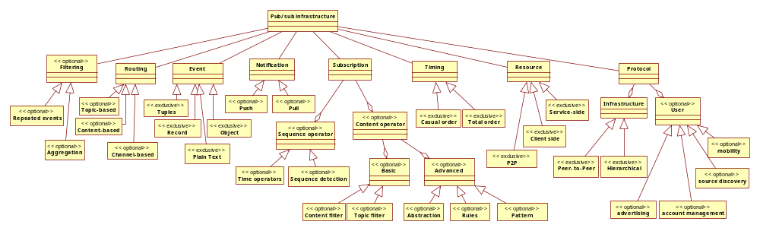
Feature Diagram
<<optional>> == OR
<<mandatory>> == AND
<<exclusive>> == XOR
UML notation of main features, and their specializations
Boxes represent features
  First level denotes essential features, with the exception of infrastructure filtering
  <<optional>> denotes optional features (non-essential)
  <<exclusive> denotes exclusive or of the features tagged with that stereotype.

Slide 46
Feature Diagram (zoom left)
<<optional>> == OR
<<mandatory>> == AND
<<exclusive>> == XOR

Slide 47
Feature Diagram (zoom right)
<<optional>> == OR
<<mandatory>> == AND
<<exclusive>> == XOR

Slide 48
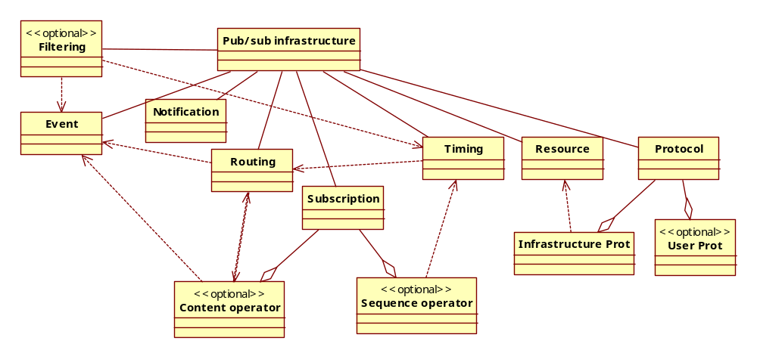
Dependency Diagram
I mean publication filtering
Dashed lines (standard UML) represent fundamental dependencies
  Changes in one dimension, deeply impacts other dimensions
  Dependencies can be of different kinds

Slide 49
Fundamental dependencies in publish/subscribe
Publishers and subscribers in general
  Implicit contract between publishers and subscribers
    subscribers need to know what to subscribe to
    publishers need to agree in a common representation of the information
Results on fundamental dependencies:
  Subscription language content operators → event format
  Subscription language sequence operators → timing
  Subscription language → routing algorithms
  Routing algorithms → event format
    Content-based, topic-based routing
  Routing algorithms → timing guarantees
  Routing algorithms → subscription

Slide 50
Dependencies among application-specific features (examples)
Mobile protocol → pull notification
Peer-to-peer publishing → peer location protocol
Content-based filtering → content-based router → structured event format
Temporal logic → timing protocols for routing events
And so on…

Slide 51
Open questions
Are there fundamental feature interference in pub/sub domain?
  Surely, there are feature dependencies
Can they be addressed by some approach?
  AOP alone is not enough.
    It only modularizes crosscutting concerns
  Is Configuration management sufficient?
    No it only manages dependencies and inconsistencies
  Can a combined approach address it?
    Maybe
  Can a redesign or use of other paradigm solve the problem?
    Maybe a multi-agent approach with late-binding can help
    This will depend on the categorization of the dependencies. Some can be solved with late binding, some with auxiliary components, and so on.

Slide 52
YANCEES as a possible solution to the problem
Traditional OO approach
It has limitations too…

Slide 53
YANCEES Solution to variability realization
Isolate (decouples) dependencies using design patterns:
  Adapters
  Factories
  Configuration managers
Provide variability in different fundamental points using different strategies:
  subscription: Plug-ins and extensible languages
  input filtering: Input and output Filters
  routing: Adapters to existing infrastructure and new routing components
  protocol plug-ins: Additional protocol and static plug-ins to integrate extra functionality
  event representation: using XML.
Runtime binding of plug-ins
Startup binding of components using a builder
Built on top of a common pub-sub core (framework)

Slide 54
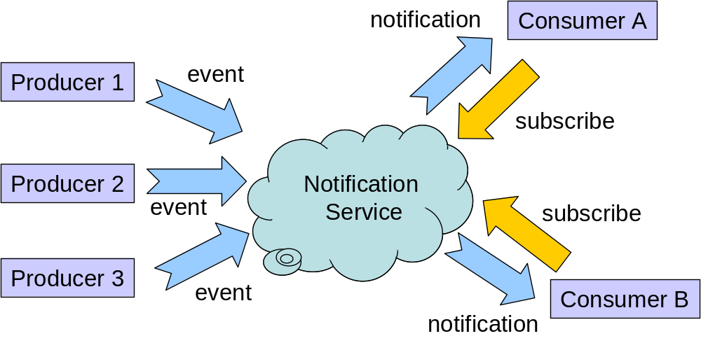
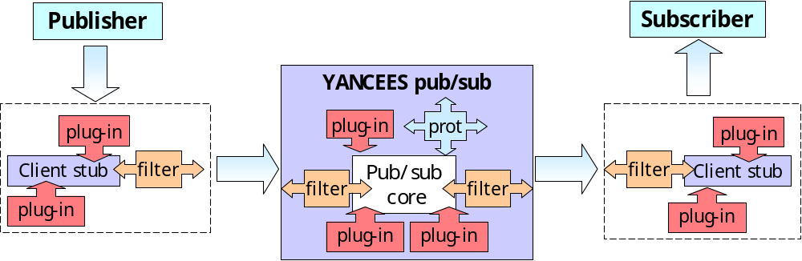
YANCEES Approach Diagram

Slide 55
YANCEES solution to dependencies management
Configuration managers
  Allows the specification of optional components
  Checks for dependencies
  Builds YANCEES instances at startup time
    Additional variability at runtime by using factories
      Plug-ins are allocated over demand
      New components can be installed at runtime

Slide 56
YANCEES shortcomings
Initial design limits the configurability to the prescribed variation points
Too many adaptation points can make the development of extensions hard
  Need to adapt different points
  Interconnect those components
  Manage conflicts and inter-dependencies
Complex configuration: different components implement a feature, and must be present at the same time
Dependencies examples
  Variability-realization specific dependencies: due to the use of filters and plug-ins: activation, sequence and use dependencies in the components are hard to manage and may cause different errors
  Fundamental: event format is crosscutting and cannot be easily changed without impacting other parts of the system

Slide 57
Accidental dependencies in YANCEES (result of the design)
Implementation-specific issues:
  Use of filters: sequential dependencies of the input and output filters:
    order matters and one filter can interfere other filters
  Use of plug-ins: need to integrate different variation points
    Concurrent dependencies of subscription plug-ins
      A sequence plug-in depends on two or more filters activated in parallel
    Use dependencies between static plug-ins and protocols
      Example: P2P publish, peer discovery and filters

Slide 58
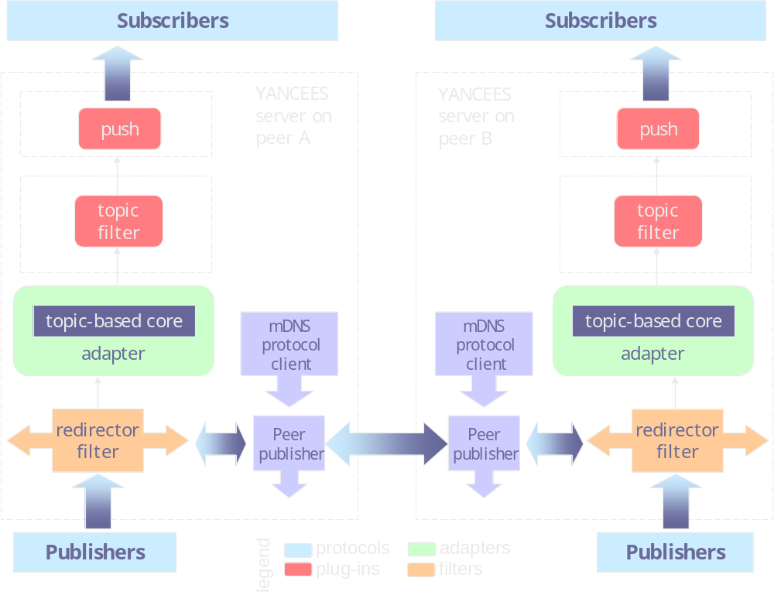
YANCEES example - impromptu
Fundamental
dependency
Use dependency
Use dependency

Slide 59
Feature Interaction in pub/sub domain
In pub/sub in general
  Due to the fundamental domain dependencies
    Event representation impacts other dimensions such as subscription and input filtering
    It is not necessarily a feature interference.
In YANCEES, they can occur due to:
  the sequence dependencies in the input-output filters
  the reuse of lower-level subscription plug-ins
    For example, same content filter for two different subscriptions

Slide 60
Crosscutting features in pub/sub domain
Also come from the fundamental dependencies, which impact the overall system implementation
  Timing
    Impacts the way subscription plug-ins and filters are implemented
  The event representation
    due to the fundamental dependencies, result in concerns spread throughout the components implementation

Slide 61
General approaches to the main problems
Parnas/Dijkstra stepwise refinement
A survey of variability realization techniques is presented at: [Svahnberg, M., J. v. Gurp, et al., 2005]
A description of common dependencies and approaches to minimize their impact are presented at [Lee and Kang 2004]
Generative programming
Essential Systems Analysis
AOP for footprint and feature management [Hunleth and Cytron 02]
Adaptive OO programming (AOOP) by [K. Lieberherr 96]
Multi-agent paradigm?

Slide 62
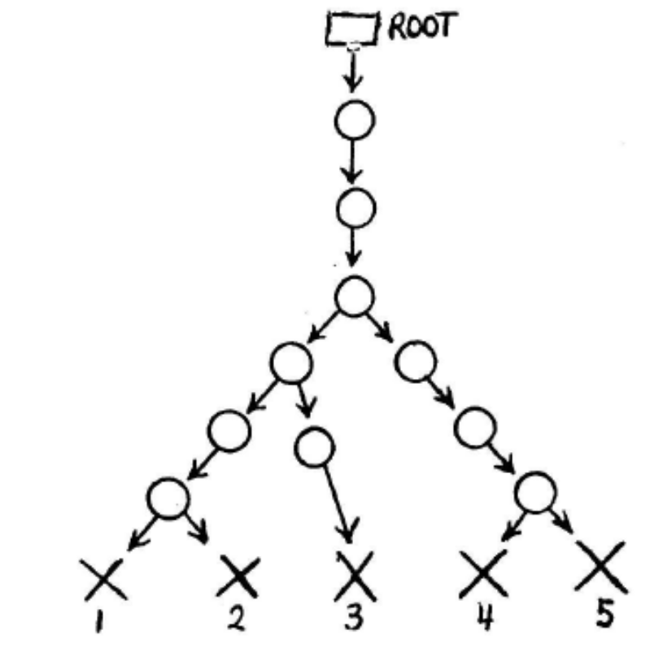
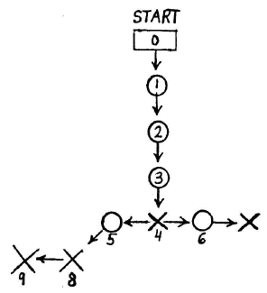
Parnas/Dijkstra stepwise refinement [Parnas 76]
Sequential completion
Programs evolve based on existing complete programs (X nodes)
Stepwise refinement
Programs are created based on incomplete program representations (circles)
Those representations are central

Slide 63
MDA – Model Driven Architectures
Industry initiative that focus on using software product lines to address platform-dependent variability:
  Hardware, programming language, network protocols, infrastructure
  Platform independence is the goal
  For example:
    different platforms: CORBA, RMI, SOA, J2ME
    Different languages: Java, C#, C++
Based on OMG models and architecture such as UML, CORBA
Prescribes sets of transformations from platform independent to platform dependent models and subsequently to source code.
  Bridge the gap between problem domain model and solution domain model.
  Application generation from higher-level models, instead of code.

Slide 64
Managing dependencies using design patterns – late binding
Generally speaking, delays the binding time of dependencies.
[Lee and Kang 2004] apply some design patterns to isolate dependencies from the components of the system:
  Proxy: isolates components encapsulation activation decisions
  Factory: performs dynamic binding based on existing criteria
  Activation Manager: resolves dependencies at runtime.
  This is actually adopted by YANCEES

Slide 65
Adaptive OO Programming (AOOP)
[K. Lieberherr 96]
Finds patterns of essential classes and their interaction, extracting their commonalities
  Detects common paths
  Removes non-essential methods and classes
  Keeping only essential methods, classes and relations.
  Results in:
    a partial class structure and
    a set of constraints that must be satisfied by customizes of a class.
Specific programs are implemented by adding methods and classes to the skeletal, essential representation of the program.
  Mechanism: performs late-binding of methods to classes in OO programs
In the author’s words…
  “While conventional object-oriented programmers bind methods explicitly to classes, adaptive programmers delay binding of methods until a class structure customizer is provided.” [K. Lieberherr 96]

Slide 66
Generative Programming
“Generative programming is about modeling and implementing system families in such a way that a given system can be automatically generated from a specification written in one or more textual or graphical domain-specific languages (DSLs) “ [Krzysztof]
It proposes a generative model:
  Initial domain analysis → domain model
  Components that implement variability and commonalities
  Configuration knowledge: dependencies, compatibilities, architecture, assembly rules…
  Program generators that integrate the components to produce requirement-specific software
Techniques used by Generative Programming include:
  GenVoca and stepwise refinement [Parnas 76]
    Augment a common base program by mixing code together.
  Program generators [Czarnecki et al.]
    Apply domain-specific languages to generate code
  Intentional programming
    Use of domain-specific languages to generate domain-specific programs

Slide 67
Generative Programming
Prescribes a domain model
Inter-component dependencies are handled in code fragments that are weaved to the base code to design customized components
  In other words, it does not eliminate the dependencies, only moves them to another level
  It also does not address the feature dependencies problems

Slide 68
Essential Systems Analysis [McMenamin and Palmer, 84]
Main concepts
Based on structured analysis
Produce an essential system model that is
  Driven by external and temporal events
  Technology independent
  Represent the essential system behavior and response
Even though designed for single software structured design, the idea of technology independence and essential system behavior is a key concept we want to use

Slide 69
Essential Systems Analysis [McMenamin and Palmer, 84]
Essential analysis will identify the core or common components of the product family in a way independent of technology
Separates essential from non-essential characteristics

Slide 70
AOP approach
Basically modularizes cross-cutting concerns, moving some dependencies to the meta-level, where they can be more easily managed
Provides a mechanism for late binding of code → good for footprint management
Example: FACET [Pratap, Hunleth, Cytron 04] implemented CORBA-NS using AOP horizontal decomposition [Jhang and Jacobsen 2004]
  Focus on footprint management
  The feature set is tailored at CORBA-NS standard: channel-based routing
  Dependency management performed by ant.
  Does not explain fundamental dependencies and their role in the customization of the system.

Slide 71
Multi-agent paradigm
Components are “intelligent” and perform runtime decisions
Those decisions are helped by agencies and auxiliary objects
They can be used to perform late-binding, handling some dependency problems using:
  Proxies
  Traders
  Agencies

Slide 72
Principles in the Product Line Design
Conclusions of the Survey: Extracted from the available techniques

Slide 73
Summary of principles
Analysis principles
  Domain Engineering
    Feature-based modeling
    Identification of commonalities and variability
  Essential analysis – fundamental dependencies identification
    Identifies fundamental dependencies and requirements for a program family
Design principles
  Stepwise refinement: develop incomplete programs (Parnas)
    Information hiding of variable dimensions and separation of concerns
  De-coupling and high cohesion
  Dependency inversion
    Use of interfaces to separate abstractions and implementations
    OO principles expressed in design patterns
  Late binding – dependency resolution
    Uses environment or configuration parameters to decide what feature to implement
  Modularization – dependency isolation, information hiding
    Minimizes dependencies coping with configuration and independent development
    AOP, AOOP, meta-level programming may help improve some hard dependencies
    OO may also help

Slide 74
The role of dependencies in OO design
Symptoms of bad OO design: rigidity, fragility, immobility and viscosity
“ What kind of changes cause designs to rot? Changes that introduce new and unplanned for dependencies. Each of the four symptoms mentioned above is either directly, or indirectly caused by improper dependencies between the modules of the software. It is the dependency architecture that is degrading, and with it the ability of the software to be maintained.
In order to forestall the degradation of the dependency architecture, the dependencies between modules in an application must be managed. This management consists of the creation of dependency firewalls. Across such firewalls, dependencies do not propagate.
Object Oriented Design is replete with principles and techniques for building such firewalls, and for managing module dependencies. “*
* Robert C. Martin. Design Principles and Design Patterns, www.objectmentor.com

Slide 75
OOD Design Principles and Rules
Goal: minimize the rigidity, fragility, immobility and viscosity of OO Design
Principles:
  Open Closed Principle
    A module should be open for extension but closed for modification.
  Liskov Substitution Principle
    Subclasses should be substitutable for their base classes.
  Dependency Inversion Principle
    High-level modules should not depend upon low-level modules. Both should depend upon abstractions
    Abstractions should not depend upon details. Details should depend upon abstractions
  Acyclic Dependencies Principle
  Law of Demeter or “Principle of Least Knowledge”
    "Only talk to your immediate friends". The fundamental notion is that a given object should assume as little as possible about the structure or properties of anything else (including its subcomponents).
  Functionality Rule
  Boundary-Controller Entity Rule
  Specialization and Generalization Rule
  Hierarchical, Modular and Layered Rule
  Design by Contract (DBC)
  And others…

Slide 76
The risk of too much flexibility
Flexibility is desirable due to changing requirements and reuse
However, there is no general solution to the flexibility problem in software engineering
Too much flexibility is not attainable due to:
  Security costs
    About OpenOffice: “A number of the problems described in the report have to do with the basic design of the software. For example, OpenOffice.org does not perform adequate security checks on the software it runs, the researcher said. And because of the extreme flexibility of the free office suite, there are many ways for writers to create malicious macros, the researchers found. “ InfoWorld, August 2006, http://www.infoworld.com/article/06/08/11/HNopenofficesecurity_1.html
  Configuration management costs
    Expression of dependencies in the configuration language
    Management of ‘incompatible’, ‘require’ dependencies
    Version management
  Debugging and program comprehension issues
    Entanglement, control and data dependencies.

Slide 77
Topic Proposal
Some ideas and directions
After talking to Crista.

Slide 78
Meeting with Crista 05/18/2006
Option 1: generative approach
  Build a product line for my own reuse → speed up software development of customized pub/sub systems
    Challenges:
      Problem domain analysis: Determine all possible variability
      Management of dependencies and incompatibilities
      Choose the best implementation approach
  Evaluation
    Compare approaches: implementation from scratch, reuse of existing systems, and use of the proposed system to build custom applications
    Use the dependency model as a guidance, to explain the observations and limitations of each approach
  Possible issues
    An AOP implementation already exists: FACET [Pratap, Hunleth, Cytron 04]

Slide 79
Meeting with Crista 05/18/2006
Option 2: open source product lines
  Question: how to build an open source infrastructure that can be extended and customized by other users?
    Main challenges:
      Usability: how can other users learn and extend my model?
      Extensibility: How to accommodate unforeseen features?
  Evaluation
    User study (how to evaluate?)
  In both options (1 and 2) we have:
    Product line architecture: components and base framework
    GUI + constraints = meta programming for automatic code generation
    The incorporation of problem fundamental dependencies as guidance in the process

Slide 80
Meeting with André 06/07/2006
What are the questions I want to answer with my model?
The role of dependencies in product line design
  How fundamental dependencies can help me choose what variability realization techniques to use?
  What kinds of dependencies exist?
  What dependencies are better addressed by what approach?
  The result will be a set of dependencies → forces → approaches model.
By using feature-based domain analysis/engineering, and considering dependencies, I expect:
  Better separation of concerns
  Better design structure
  A reduction in feature interaction
  Better understandability of my product family → better extensibility and reuse
What’s conceptually different from FACET?
  Broader model, that includes content-based pub/sub
  A step back:
    conceptual fundamental dependencies as guidance to produce the base system
    Non-fundamental dependencies are secondary
    FACET provides a good approach for feature dependency management, testing and weaving, but does not answer more fundamental questions as those

Slide 81
My own ideas after meeting with Redmiles 06/07/2006
On the criteria to be used when defining variability and commonalities: the role of dependencies
  How fundamental problem dependencies impact the variability of the system?
  What are the impacts of dependencies in modularization?
    What kinds of dependencies are modularizable and which ones are not?
How to tame dependencies using existing techniques?
  Get the event-routing-subscription dependency and experiment with:
    AOP
    Mixings
    OO
    Adaptive Programming
What if there are restrictions in the set of techniques to be used?
  AOP cannot be always used (ex. Palm OS JDK constraints)
  Some systems may require traditional structured programming alone (legacy code)

Slide 82
Meeting with Redmiles 06/07/2006
Criteria 1: Use information Hiding as suggested by Parnas:
  Modularize commonalities hiding concerns
  Add variation points around it
If I cannot completely modularize the problem with OO, try use AOP
  AOP breaks information hiding.
Criteria 2: Try using FSE 2005 approach
  DSMs and dependencies as a criteria for aspect definition.
  Plus the proper code management since information hiding is broken
Compare both approaches in a high-level model
  Define a kind of catalog explaining the forces one should consider when selecting one approach or another.

Slide 83
Other insights
According to Parnas, information hiding, and not the execution order (flow chart), should be the criteria used to modularize systems
  Modules should depend on one another through a use relation
Matching (event→ subscription) is a concern of the event or of the infrastructure?
Modularization Criteria: cohesion and information hiding
  If event format varies too much, matching must be moved to the event
  But the criteria must be standardized so the event can know what to expect
  Hence, it is hard to isolate the matching criteria and the event representation

Slide 84
Other insights (cont.)
Subscription → event. What information should be hidden here? The matching operation should be common to both.
  Matching should be the concern that isolates events and subscriptions.
Can we modularize dependencies? In other words, create components that do not depend on one another?
  Maybe dependencies can be constructed at runtime
  Components have contracts

Slide 85
Build a DLS and Generators
Create a language that expresses the program behavior and that incorporates the idea of extensibility on it
  LISP program with rules that are easily extensible
  DSL with <extends> <plugs> <unplugs>
  Generate code from it using modern techniques

Slide 86
Parnas’ approach
Software Families
Flexibility
Approach to design flexible software

Slide 87
Parnas’ Criteria of Decomposition
Information Hiding Principle
The criteria involves variability and commonality determination
  “ We have tried to demonstrate by these examples that it is almost always incorrect to begin the decomposition of a system into modules on the basis of a flowchart. We propose instead that one begins with a list of difficult design decisions or design decisions which are likely to change. Each module is then designed to hide such a decision from the others. Since, in most cases, design decisions transcend time of execution, modules will not correspond to steps in the processing. To achieve an efficient implementation we must abandon the assumption that a module is one or more subroutines, and instead allow subroutines and programs to be assembled collections of code from various modules. “

Slide 88
Parnas’ Software Family Motivation
According to Parnas [Parnas 78], software change is usually driven by the need to support:
  (1) Extensions motivated by social, organizational or technological evolution;
  (2) New and different hardware configurations;
  (3) Differences in its input and output data, while its function is preserved;
  (4) Different data structures and implementations due to differences in the available resources;
  (5) Differences in the size of data input and output;
  (6) And the need of some users of only a subset of features provided by the software.
Solution: design software as a product family instead of a single product [Parnas 76].

Slide 89
Factors that hinder software evolution
Main factors that hider the program flexibility, according to Parnas [Parnas’76]:
  Excessive information distribution
    Programs are written assuming the presence or absence of a feature.
  Chain of data transforming components
    Incompatible inputs and outputs are common
    Originating order dependencies between components
  Components that perform more than one function
  Loops in the “uses” relation
    Circular dependencies: programs are ready only when all components are ready

Slide 90
Parnas’ generality principles
According to [Parnas’78]
  Generality as seen by mathematicians:
    Solutions applicable without change to many situations
  Generality as seen by engineers
    A solution/product that can be tailored to the situation at hand
    Efficiency and fitness to the problem are required
  Generality comes with runtime costs
  Flexibility supposes efficiency
  Parnas proposes the principles of
    Anticipation of change: identify the main feature variability first
      Commonalities: minimal subset
      Variability: minimal increments
    Information hiding: hide the variability behind fixed interfaces
      Lose coupling: hide information about components from one another
      Abstract data types: hide implementation and structure details
    Separation of concerns: modularization and specialization
      Virtual machine approach instead of transformation flow

Slide 91
Parnas’ virtual machine approach
Parnas’ Virtual machine approach (domain engineering)
  Virtual machine that has instructions operating over a set of small data types
  System is designed as a subset of programs
  Users customize the software by programming over or invoking existing subset
  Or writing incremental implementation of new instructions or data types
The virtual approach must be constrained such that the “uses” hierarchy has no loops.
Layered architecture: The program is built according to different abstraction levels
“Sandwitching”: When a circular dependency is unavoidable, a program must be split in two or more subprograms achieving a tree-like structure
  refactoring does pretty much this
Different from a kernel approach, where changes in the kernel impact the whole system.

Slide 92
AOP, Adaptive Programming and Aspectual Components
Those three technologies may help in modularizing dependencies.
According to D. Batory, the criteria to be used is stepwise refinement, using mixins and types as parameters (constrained parametric polymorphism) added in layers – see Java Layers.
  One component = one feature, and has implementation for different classes

Slide 93
Little experiment design
Build a simple pub/sub using OO
Build using AOP
Build using Mixings (parameterized classes)
Build using design patterns
Understand the role of coupling and the flexibility achieved in each approach
Characterize the kinds of dependencies, especially event → routing → subscription
Finally build a “criteria”, in the form of a catalog of dependencies → realization techniques
This may lead to better understanding and generalizations

Slide 94
Quotes
“CORBA's numerous technical flaws have accumulated to a point where it is difficult to fix or add anything without breaking something else. For example, every revision of CORBA's interoperability protocol had to make incompatible changes, and many fixes and clarifications had to be reworked several times because of unforeseen interactions with features that were added over time. “. ACM Queue vol. 4, no. 5 - June 2006 by Michi Henning, ZeroC

Slide 95
Managing dependencies
Build a feature dependency model
  Early identification is a key thing
Characterize the dependencies
  Identify fundamental (common) and feature-specific dependencies
Find transition paths between dependencies, for example:
  Filtering → event
  Filtering → timing
  Timing → Routing → event
  Routing → content operator
  …
Apply the modularization criteria based on the nature of the dependency:
  Separation of concerns
    Using information hiding (OO), aspect-oriented programming (AOP), mixins, others.

Slide 96
References
Bosch, J., G. Florijn, et al. (2001). Variability Issues in Software Product Lines. 4th International Workshop on Software Product Family Engineering - PFE'2002, Bilbao, Spain, Publisher: Springer Berlin / Heidelberg.
Bosh, J. (2000). Design & Use of Software Architectures - Adopting and Evolving a Product Line Approach, Addison-Wesley.
Coplien, J., D. Hoffman, et al. (1998). Commonality and Variability in Software Engineering. IEEE Software. 15: 37-45.
Griss, M. L. (2000). Implementing Product-Line Features with Component Reuse. 6th International Conference on Software Reuse, Vienna, Austria.
Kang, K. C. (1998). "FORM: A Feature-Oriented Reuse Method with Domain Specific Architectures." Annals of Software Engineering 5: 345-355.
Kang, K. C., S. G. Cohen, et al. (1990). Feature-Oriented Domain Analysis (FODA) Feasibility Study - CMU/SEI-90-TR-021. Pittsburgh, PA, Carnegie Mellon Software Engineering Institute.
Kiczales, G., J. Lamping, et al. (1997). Aspect-Oriented Programming. European Conference on Object-Oriented Programming, Jyväskylä, Finland, Springer-Verlag.
Lientz, B. P. and E. B. Swanson (1980). Software Maintenance Management: A Study of the Maintenance of Computer Application Software in 487 Data Processing Organizations (Ch. 27). Rading, MA, Addison-Wesley.
S. M. McMenamin and J. Palmer, Essential Systems Analysis. Englewood Cliffs, NJ: Yourdon Press Prentice Hall, 1984.

Slide 97
References (cont)
Mezini, M. and K. Lieberherr (1998). Adaptive plug-and-play components for evolutionary software development. 13th ACM SIGPLAN conference on Object-oriented programming, systems, languages, and applications, Vancouver, British Columbia, Canada, ACM Press.
Ommering, R. v., F. v. d. Linden, et al. (2000). The Koala Component Model for Consumer Electronics Software. IEEE Computer. 33: 78-85.
Parnas, D. L. (1972). On the Criteria to Be Used in Decomposing Systems into Modules. Communications of the ACM. 15: 1053-1058.
Parnas, D. L. (1976). "On the Design and Development of Program Families." IEEE Transactions on Software Engineering SE-2(1): 1-9.
Parnas, D. L. (1978). Designing software for ease of extension and contraction. 3rd international conference on Software engineering, Atlanta, Georgia, USA, IEEE Press.
Sommerville, I. (2001). Software Engineering (6th Edition).
Svahnberg, M., J. v. Gurp, et al. (2005). "A Taxonomy of Variability Realization Techniques." Software Practice and Experience 35(8): 705-754.
Trigaux, J. C. and P. Heymans (2003). Modelling variability requirements in Software Product Lines: A comparative survey. Namur, Belgium, Institut d’Informatique FUNDP.
van Gurp, J., J. Bosch, et al. (2001). On the notion of variability in software product lines. Working IEEE/IFIP Conference on Software Architecture - WICSA'2001, Amsterdam, IEEE.
Karl Lieberherr. Adaptive Object-Oriented Software: The Demeter Method with Propagation Patterns, PWS Publishing Company, ISBN: 0-534-94602-X, 1996.
R. M. Pratap, F. Hunleth, and R. K. Cytron, "Building fully customisable middleware using an aspect-oriented approach," IEE Proceedings - Software Engineering, vol. 151, pp. 199-216, 2004.

Slide 98
References (cont)
Wilde, N., P. Matthews, et al. (1993). "Maintaining object-oriented software." IEEE Software 10(1): 75-80.
McIlroy, M. D. (1968). Mass Produced Software Components. In Software Engineering: A Report on a Conference Sponsored by the NATO Science Committee. P. Naur and B. Randell (eds.), Garmisch, Germany.
Brooks, F. P. (1987). No Silver Bullet: Essence and Accident in Software Engineering. IEEE Computer 20. 10: 10-19.
Cameron, E. J. and H. Velthuijsen (1993). "Feature interactions in telecommunications systems." IEEE Communications Magazine 31(8): 18-23.
Lee, K. and Kang, K.C. Feature Dependency Analysis for Product Line Component Design. Lecture Notes in Computer Science - 8th International Conference on Software Reuse, ICSR'04, 3107. 69-85.
Hunleth, F. and Cytron, R.K., Footprint and feature management using aspect-oriented programming techniques. in Joint conference on Languages, compilers and tools for embedded systems: software and compilers for embedded systems, (Berlin, Germany, 2002), ACM Press, 38 - 45.
Sanchez, C., Sankaranarayanan, S., Sipma, H., Zhang, T., Dill, D. and Manna, Z. Event Correlation: Language and Semantics. Embedded Software (EMSOFT), LNCS 2855. 323-339, 2003.
Zhang, C. and Jacobsen, H.-A., Resolving feature convolution in middleware systems. in 19th annual ACM SIGPLAN Conference on Object-oriented programming, systems, languages, and applications, (Vancouver, BC, Canada, 2004), ACM, 188-205.

Slide 99
References (cont)

Slide 100
Backup slides

Slide 101
Feature internal dependencies - consequences
Runtime binding
  There is a need for reflection: location of the other components that implement the feature
Build time binding
  Dependencies can be resolved by the compiler

Slide 102
Software Variability Analysis
Scope Commonality Variability (SCV) model
Main Steps:
  Establish the scope
  Identify the commonalities and variability
  Bound the variability by applying limits to them
  Exploit the commonalities
  Accommodate the variability
Existing methodologies
  SCV, FODA, FORM

